Slide 1
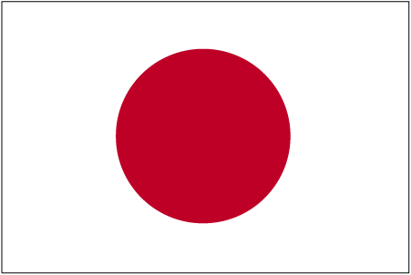
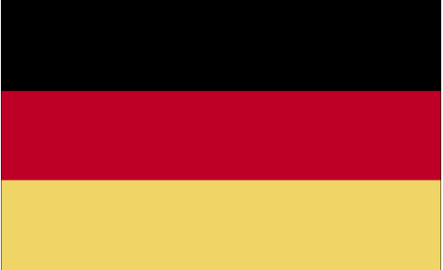
SME as a Success Story in Germany and Japan - Approaches for Mutual Learning - Prof. Dr. Martin POHL University of Tsukuba, Japan
martinpohl@gmx.net
pohl.martin.gf@u.tsukuba.ac.jp
Handout -
石川日独協会
July 27, 2013
Notes:
http://www.business.gov.vn/asmed.aspx?id=2272
http://www.ncseif.gov.vn/sites/en/Pages/primeminister-sdecisionprovidingfunctions-responsibilities--nd-6820.html

Slide 2
Overview
Search for a Definition of SME
The Place of SME in Germany
How is German Politics Involved in the Support of SME?
Digression: What did the government do for SME after the Lehmann-crises
Today‘s Contributions of SME to the German Economy
Examples of Global Competitive SME in Germany
SME in Future: Contribution of Science
Outlook: 1870 versus 2012

Slide 3
Search for a Definition of SME - Quantitative Aspect -
SME are a group of enterprises – regardless of the economic sector – which are not exceeding a certain size.
Indicators for size may be: (i) Profit, (ii) Fixed assets, (iii) Balance sheet total, (iv) Value added, (v) Number of staff, (vi) Turnover etc.
Problems: (i) Each economic sector has its specialties, (ii) statistical data are often not available, (iii) SME is created by merger or spin-offs, but part of a conglomerate.

Slide 4
Search for a Definition of SME - Qualitative Aspect -
An important criteria for an SME is the close relationship between the enterprise and the entrepreneur free of dependence on a conglomerate:
Entity of risk of the company and its managers.
The SME-management is included in all relevant business decisions.
That determines the relationship between management and employees, the internal company organization, the way of decision-finding, the structure of finance, the market behavior and the relation between company and company environment.

Slide 5
Search for a Definition of SME - German Administration-
1970: The federal government drafted a SME-policy: „A general … definition of the terminus of SME is not helpful. … For specific purposes borderlines may be drawn: Industrial small enterprise up to 49 staff and medium size enterprise up to 499 staff.
(Source: German Parliament, Paper VI/1666, Dec 29,1970)
The German Employers Association says: „Whereas in other European countries SME are statistically defined as part of the economy, in Germany SME are going beyond such statistics: SME include both economic as well as social aspects.“
(Source: Bundesverband der Deutschen Industrie (Ed.): Großindustrie und industrieller Mittelstand. Gemeinsam erfolgreich im Wettbewerb, Köln 1999, p.31)

Slide 6
How are SME‘s Categorized in the German Language?
„Kleine und Mittlere Unternehmen (KMU, SME)“ are described:
Quantitative: “Mittelstand”
Qualitative: Family owned companies
Sociology: Middle Class (Definition of the monolingual dictionary „Duden“)
Cover of the book in the medieval style by Walter WILHEM, Willy SCHLUETER:
„Mission of the Mittelstand“ (1924)

Slide 7
Summary: No General Accepted German Definition of SME
In Germany there is no general defined criteria for SME by public authorities. In certain fields are criteria fixed, such as in specific government support programs or in the trade law for small limited liability companies (two of three criteria have to be fulfilled: 350.000 Euro balance sheet total, 700.000 Euro turnover and up to 10 staff).
In the field of science the definition of the “Institut für Mittelstandsforschung (IfM)“, a public foundation supported by the Federal Ministry of Economy and the State Government of Northrhine-Westfalia is most widely accepted:
Small Enterprise: up to 9 staff and up to 1 Mio. € turnover Medium Enterprise: up to 499 staff and up to 50 Mio. € turnover
http://www.ifm-bonn.org/index.php?id=89, <accessed Nov. 15, 2012>
Notes:
http://www.ifm-bonn.org/index.php?id=89

Slide 8
What is an SME in the European Union
The EU-Commission defined by EU-Law SME’s, considering the rage of definitions by EU-countries (for example: Belgium, the Netherlands and Denmark: up to 100 employees, France and Italy up to 499 employees, UK up to 249 employees):
Company Category | Medium-sized | Small | Micro
Employees | < 250 | < 50 | < 10
Turnover (or) | <50 m | < 10 m | < 2 m
Balance sheet total | < 43 m | < 10 m | < 2 m
These ceilings apply to the figures for individual firms only. A firm which is part of larger grouping needs to include employee/turnover/balance sheet data to that conglomerate.
The definition is compulsory used by all EU-institutions, however, it is becoming gradually also common in the member-states including Germany though it is not an EU-regulation which has to be enforced by member-states into national law.
Source: http://ec.europa.eu/enterprise/policies/sme/facts-figures-analysis/sme-definition/index_en.htm < accessed Sept. 29, 2012>

Slide 9
What is an SME in Japan
Japan Small and Medium-sized Enterprise Basic Act, Article 2:
(1)Any entity which is a company whose capital or total amount of investment does not exceed three hundred million yen (300,000,000 yen), or a company or an individual whose regular workforce does not exceed three hundred persons, and which is principally engaged in manufacturing, construction, transportation or any other category of business (except those categories of business mentioned in any of items (2) to (4) below);
(2)Any entity which is a company whose capital or total amount of investment does not exceed one hundred million yen (100,000,000 yen), or a company or an individual whose regular workforce does not exceed one hundred persons, and which is principally engaged in the wholesale trade;
(3)Any entity which is a company whose capital or total amount of investment does not exceed fifty million yen (50,000,000 yen), or a company or an individual whose regular workforce does not exceed one hundred persons, and which is principally engaged in the service industry;
(4)Any entity which is a company whose capital or total amount of investment does not exceed fifty million yen (50,000,000 yen), or a company or an individual whose regular workforce does not exceed fifty persons, and which is principally engaged in the retail trade.
Souce: Small and Medium Enterprise Agency: http://www.chusho.meti.go.jp/sme_english/outline/08/01.html <accessed July 22. 2013>

Slide 10
Comparison Japan-Germany
Japan is using basically static data („capital invested“) and differentiates in economic sectors which are employee orientated.
Germany is using dynamic data (staff/turnover) which are productivity orientated.

Slide 11
The Place of SME‘s in Japan
Source: Japan Institute of Labour and Training,
http://www.jil.go.jp/english/workinglifeprofile/2012-2013/03/p.22_3-12.pdf <accessed July 22, 2013>

Slide 12
The Place of SME‘s in Germany – a Tautology ?
 | Total | SME | SME in %
Companies (2010) | 3,68 Mio. | 3,67 Mio. | 99,7 %
Turnover of companies (2009) | 4.978,94 Bio. € | 1.947,97 Bio. € | 39,1 %
Employees subject to social insurance contribution (2009) | 25,17 Mio. | 15,29 Mio. | 60,8 %
Apprentices (2010) | 1.62 Mio. | 1,35 Mio. | 83,2 %
Source: “Institute fuer Mittelstandsforschung” IfM in Bonn, using IfM-criteria
http://www.ifm-bonn.org/index.php?id=99 <accessed May 5, 2012>
When 99,7 % of all German companies are regarded as SME’s, it is a tautology to say that SME’s are the “Economic Heart of Germany”.

Slide 13
SME - Going into Detail
EU-criteria | Companies (%) | Employees (%) | Turnover (%) | Gross investment in fixed assets (%) | Gross value added at factor cost (%)
SME (in total) | 99,3 | 60,9 | 34,3 | 45,7 | 46,7
Very small (micro) companies: To 9 staff To 2 Mio. Euro turnover | 80,9 | 18,7 | 6,7 | 14,6 | 11,4
Small companies: To 49 staff To 10 Mio. Euro turnover | 15,3 | 22,3 | 11,5 | 15,0 | 16,5
Medium size companies: To 249 staff To 50 Mio. Euro | 3,1 | 19,9 | 16,1 | 16,2 | 18,8
Large Companies | 0,7 | 39,1 | 65,7 | 54,3 | 53,3
Source: https://www.destatis.de/DE/ZahlenFakten/GesamtwirtschaftUmwelt/UnternehmenHandwerk/KleineMittlereUnternehmenMittelstand/Tabellen/Insgesamt.html
<accessed Nov 18,2012>

Slide 14
 | Economic sector | Total (companies) | 0 to 9 | 10 to 49 | 50 to 249 | More than 250
B | Mining | 2 411 | 1 815 | 473 | 100 | 23
C | Manufacturing | 258 222 | 195 049 | 44 442 | 14 941 | 3 790
D | Energy | 38 825 | 37 528 | 640 | 481 | 176
E | Water / waste management | 12 931 | 9 581 | 2 474 | 749 | 127
F | Construction | 385 898 | 351 099 | 31 808 | 2 775 | 216
G | Trade | 691 757 | 632 085 | 49 983 | 8 220 | 1 469
H | Transport | 124 287 | 106 023 | 14 831 | 2 936 | 497
I | Restaurants | 258 802 | 244 628 | 12 406 | 1 586 | 182
J | Information and Communication | 129 303 | 119 031 | 7 904 | 1 979 | 389
K | Banking and insurance | 71 967 | 67 663 | 2 227 | 1 304 | 773
L | Real estate | 313 139 | 309 509 | 3 092 | 479 | 59
M | Scientific and technical consulting | 495 043 | 469 552 | 22 061 | 2 938 | 492
N | Other business services | 186 469 | 167 864 | 12 672 | 4 771 | 1 162
P | Education | 72 493 | 60 607 | 9 789 | 1 689 | 408
Q | Health and welfare service | 235 666 | 200 753 | 25 252 | 7 705 | 1 956
R | Art and entertainment | 102 222 | 98 911 | 2 704 | 508 | 99
S | Other services | 241 141 | 229 704 | 9 228 | 1 873 | 336
 | Total (EU-Criteria) | 3 620 576 | 3 301 402 | 251 986 | 55 034 | 12 154
https://www.destatis.de/DE/ZahlenFakten/GesamtwirtschaftUmwelt/UnternehmenHandwerk/Unternehmensregister/Tabellen/UnternehmenBeschaeftigtengroessenklassenWZ08.html

Slide 15
Structure of German Companies
Companies (Total, all size) | 2010 | 3 620 576
SME (EU-Definition) | 2010 | 3 608 422 (99,3 %)
Craft enterprises (all size, mostly SME) | 2009 | 573 311
Companies owned by foreign capital (all size, many not SME) | 2010 | 26 934
New company registrations (all size, mostly SME) | 2011 | 821 207
De-listings of companies (all size, mostly SME) | 2011 | 715 136
Company insolvencies (all size, mostly SME) | 2011 | 30 099
The high number of delisted companies shows: Many German SME are either not competitive companies or companies which have been founded for other reasons as making business.
https://www.destatis.de/DE/ZahlenFakten/GesamtwirtschaftUmwelt/UnternehmenHandwerk/Unternehmensregister/Unternehmensregister.html

Slide 16
Is the Role of SME related to a Myth in the German Context?
The majority of the German economists of the 19th and early 20th century consider SME as hindering economic development.
They presumed that innovation and industrialization require concentration.
Political support for SME was regarded in Germany until the end of World War II mainly as “bourgeois” or “romantic”. Any political support for SME’s was justified with welfare policy.

Slide 17
Large Companies versus SME
Theory 1: John Kenneth Galbraith highlighted 1967 the benefit of economies of scale: as production becomes larger, greater specialization of labor and machines is possible. Large firms have lower costs as than small ones, and therefore dominate society.
Theory 2: Peter Schumpeter argued 1934 that entrepreneurs are different from those who solely manage businesses without innovating. Innovations create new demand and entrepreneurs bring the innovations to the market. This destroys existing markets and creates new ones – an ever ongoing process of “creative destruction”.
The discussion if large or small companies may contribute more to a society is from my point of view contra-productive: both large and small companies may have entrepreneurs in Schumpeter's sense. And small enterprises may be more (and faster) specialized as large enterprises – depending on the economic sector. - “Entrepreneur” is a terminus not related to politics – his function is only to create value in a society. How the value is distributed in a society is beyond his work – and for good reasons not discussion of this presentation.

Slide 18
How is German politics involved in support of SME?
To understand that question, some information of the rather unique economic system of Germany, the social market economy, has to be given. One indicator of this system is, that in companies with more than 2.000 staff worker‘s representatives hold halve of the seats of supervisory boards.
German political support for SME is embedded in this system of a social market economy.

Slide 19
What is Social Market Economy – German Style?
In a soccer game, players can play following their own decision on the lawn to win.
To have a fair play among the players, rules give directions and limitations for their game.
The players who loose get another chance in the next game.
In case the environment changes (new technical equipment, different social behavior) the rules may be change.
In Social Market Economy, the lawn is the market and the rules are given by the state.

Slide 20
German Social Market Economy consists of constitutive and regulatory principles
Constitutive Principles: | Regulatory Principles:
Priority of Monetary Stability | Independent Antitrust Policy
Open Markets | Social Equality
Property Rights | Internalization of Externalities
Freedom of Contract | Prevention of Market Failures
Liability

Slide 21
German Social Market Economy – Regulatory Principles
Whereas in Germany the constitutive principles are generally accepted by the influential groups in society, the public discussion is focused on the regulatory principles. They can be divided in two sub-groups:
Institutional Level | Operational Level
Market Participation and Market Openness | Stability of Financial Markets, e.g. Regulation and Supervising of Banking
Market Entry Regulations | Monetary Policy with Focus on Inflation Control Based on Independent Institutions
Equality of Opportunities | Fiscal Policy Bringing Government Expenditures and Debts in Balance
Protection of both Competition and Avoiding Abuse of Dominance | Taxation System which is Balanced and Efficient
Independence of Competition Authorities | Labor Market Policy with Employer-Employee Parity
 | Social Policy with a Guaranteed Minimum Social Security

Slide 22
Postwar History of German politics for SME
Late 1940s: SME-lobbyists requested special taxes for large companies to reduce their power. The demand was not fulfilled.
1948: Currency reform
Early 1950s: The government gave cheap loans to refugees coming from the former East part of Germany (today Poland und Russia).
1958: Introduction of the Competition Act
Early 1960s: SME could benefit from a recruiting strategy of foreign workers
Since the late 1960s government support was highly related to economic stimulus programs (German Stability and Growth Law 1967).
1992 Treaty of the European Union with free flow of goods, people, services and capital
During the entire time SME could not decouple from economic circles, however, they worked as automatic stabilizer and buffer for the German economy.

Slide 23
Who in German Politics Supports SME?
The federal government, in particular the Federal Ministry for Economy and Technology with operational support of the German Bank for Reconstruction (KfW) and the Federal Ministry for Education and Science.
The 16 federal states and their ministries for economy
Information on support by the federal government and the state government : http://www.foerderinfo.bund.de/en/index.php
The local level (11442 cities and communities)
The EU influences directly and indirectly many decisions of German SME politics.

Slide 24
Support for SME: What is German Politics Doing Today?
The 99,7 % of German companies defined as SME will find themselves in very different situations depending on the economic sector they do business, its intensity of innovation, its activity in exports etc.
Though, the German Ministry of Economy launched 2011 for SME a special support program: “Building on the Mittelstand: Strengthening Responsibility – Increasing the Scope for Development”. It is focusing on seven circles, which the ministry regards as crucial for the success of SME’s:
1. Innovations, 2. Skilled labor, 3. Transfer of companies to the next generation and company formations, 4. Exports, 5. Finance, 6. Raw materials, energy and production efficiency, 7. Cutting bureaucracy.

Slide 25
What else is politics doing?
Many other political initiatives with particular focus are brought on track. Most of them have the function to convince expectations of voters or lobbying-groups. On the economy as a whole these initiatives have little impact.
An example would be the program: “Initiative Energy-Turn-Around for SME" launched on October 1st, 2012. SME may receive special training how to enter into the rapidly growing market of energy-saving and renewable energies.

Slide 26
Digression: What did the government do for SME after the Lehmann-crises
IMF estimated that Germany spent of stimulus-programs:
2008: 0,1% of GDP, 2009: 1,6 GDP, 2010: 0,9%
Some elements of the stimulus programs:
Short-time-work-subsidies were permitted up to 24 months (usually up to 12 months).
For old cars a premium was paid when buying an energy-efficient new car.
Already decided public construction works were pulled forward.
Through the Bank for Reconstruction about 100 Bio. € were provided to supply private companies with short term loans (Note: German Companies are mainly financed with bank loans, not by equity).
All programs were ended latest 2011. All programs were not focused specifically on a particular size of company, including SME.
Source: http://de.wikipedia.org/wiki/Konjunkturpaket_II <accessed: 15 Nov. 2012, in German only>

Slide 27
Digression:“Small Business Act” of the EU-Commission
(Note: The Small Business Act is a recommendation (“member states are invited ...”) of the EU-Commission towards the member-states.)
I Create an environment in which entrepreneurs and family businesses can thrive and entrepreneurship is rewarded.
II Ensure that honest entrepreneurs who have faced bankruptcy quickly get a second chance.
III Design rules according to the “Think Small First” principle.
IV Make public administrations responsive to SMEs’ needs.
V Adapt public policy tools to SME needs: facilitate SMEs’ participation in public procurement and better use State Aid possibilities for SMEs.
VI Facilitate SMEs’ access to finance and develop a legal and business environment supportive to timely payments in commercial transactions.
VII Help SMEs to benefit more from the opportunities offered by the Single Market.
VIII Promote the upgrading of skills in SMEs and all forms of innovation.
IX Enable SMEs to turn environmental challenges into opportunities.
X Encourage and support SMEs to benefit from the growth of markets.
Source: http://eur-lex.europa.eu/LexUriServ/LexUriServ.do?uri=CELEX:52008DC0394:DE:NOT <accessed Nov 15, 2012>

Slide 28
Today‘s Contributions of SME to the German Economy
Employment: The often labor-intensive production of SME make them easier to create jobs. But: often SME-jobs are low paid -or- SME’s cannot find suitable qualified staff.
Political risk: Young people at the (lower) end of the education pyramid are left without a suitable education.
Structural Change: The cycles of technical development are becoming shorter. SME may help to compete in these global cycles – in best case by leap frogging.
Political risk: Following a short-term orientated preserving structural policy.

Slide 29
Today‘s Contributions of SME to the German Economy
Global Economy: More than 300.000 SME are involved in exports.
Political risk: exports are enforced because of (temporary) sluggish home markets.
Innovation: The success of SME is based on innovation, however, only about 30.000 SME’s are involved in permanent research.
Political risk: SME cannot employ specialists to manage the complex bureaucratic structures for public funding supporting innovation.

Slide 30
Main Reasons for Difficulties of SMEs in Germany
Difficulties of SME are mainly focused on people, not on capital. Set into hierarchical level, SME have problems because of:
Difficulties in finding suitable staff
Limitations in access to innovative customers
Lack of ability to use new technologies
Missing financial resources
Governmental SME-support in Germany should be focused on general education and on science and R&D, however respecting the core of a social market economy: allocation-free support.

Slide 31
Main Reasons of Difficulties of SME in Japan
Large companies have the monopoly on talented people.
The education system encourage uniform attitudes and discourage differences of opinion and creativity.
Small manufacturing organizations are in its majority subcontractors and as such they will not be able to innovate independently.
They will have more difficulties to implement management techniques such as quality control circles.
They are dependent on the local banking system.

Slide 32
Japanese SME-Policies
Management Support
(Fields of government activities: Start-ups and ventures, Business innovation, New collaboration, Business revitalization, Employment and human resources, Globalization, Trade practices and public procurement, Business stability, Mutual aid system, Small and medium manufacturers, Technological innovation, IT and energy efficiency, Intellectual property, SME Assistance Centers)
Financial Support
(Fields of government activities: Safety-net guarantee program, Safety-net loans)
Fiscal Support
(Fields of government activities: Taxation, Accounting, Information on Companies Act, Business succession)
Commerce and Regional Support
(Fields of government activities: Revitalization of commerce, Regional industries, Collaboration between agriculture, commerce and industry, "Meet and Experience Regional Attractiveness" campaign)
Source: Ministry of Economy and Trade, Japan. http://www.chusho.meti.go.jp/sme_english/outline/04/01_09.html <Accessed July 22, 2013>

Slide 33
Digression: The Discussion during the Korean Presidential Election Campaign 2012
Korean “Cheabol” (Japanese “Kereitsu” 系列 without a bank in its center) represent a huge economic power: the 30 biggest companies produce 90 % of the of the Korean GNP.
They risk is that Chaebol squeeze out any growth of SME, about this there was a general agreement.
The political discussion was: breaking up the Cheabol to smaller (and speedier units) or saying that threatens the export-depending Korean industry. The opponents suggest to support SME so they may find their place beside the existing Chaebol.

Slide 34
Examples of Global Competitive SME in Germany
The following examples of SME have in common: they are innovative, and they are often globally orientated.
Innovation and success in global markets can be in:
a technically highly specialized field such as roller coasters.
a new technology such as nano-technology or industrial digital cameras.
a traditional crafts product such as curtains in a sophisticated context such as for operas and theatres.
a traditional crafts product in outstanding quality and size including global maintenance service (organ).
The examples show at the same time, that there are no specific competitive factors of SME.

Slide 35
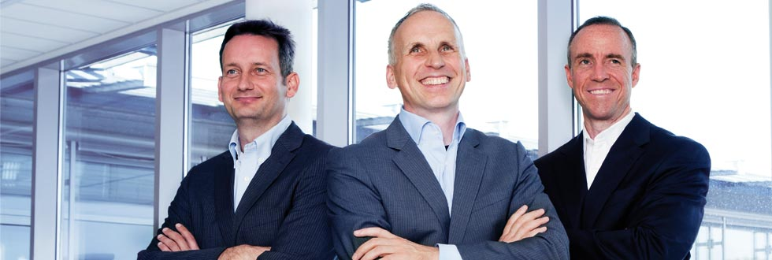
Basler AG
Founded 1988
Staff: about 250
Basler is a world-leading developer and manufacturer of high-end digital cameras for industrial, video surveillance, medical, and traffic applications.
Basler also develops and markets turnkey solutions for surface inspection.
http://www.baslerweb.com/

Slide 36
Gerriets GmbH
Founded: 1946
Staff: 180
Gerriets provides theatrical systems and scenery products to countries around the world: A wide variety of traditional, theatrical fabrics both structural and decorative.
Customers are all mayor theatres in the world: Royal Opera House in London, Sydney Theatre Company, Bolshoi Theatre in Moscow, Metropolitan Opera New York City, etc.
http://www.gerriets.us/us/index.php

Slide 37
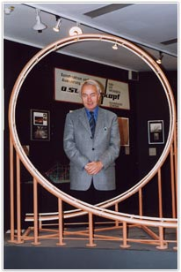
Stengel Engineering
Founded: 1965
Staff: 10
Business: Amusement Rides of any kind. Providing professional services for almost all major Amusement Rides suppliers / manufacturer and Amusement Parks worldwide.
We worked on more than 600 Roller Coasters and more than 600 other moving structures.
http://www.rcstengel.com/

Slide 38
Johannes Klais Orgelbau GmbH & Co. KG
Founded: 1882
Staff: 65
Building of organs for concert halls, churches and public buildings around the globe, for example: Beijing, National Center for Performing Arts; Kuala Lumpur, Petronas Philharmonic Hall; Moscow, International House of Music
http://www.klais.de/index.php?newlang=english

Slide 39
Omicron Nanotechnology GmbH
Founded: 1984
Staff: 100
Omicron Nanotechnology is the world’s leading supplier of analytical instrumentation solutions in nanotechnology research and development. The company creates innovative instrumentation and combines analytical tools into sophisticated multi-technique analytical systems.
http://www.omicron.de/en/our-company

Slide 40
Lessons learnt from Successful SMEs
It is crucial to break the vicious circle of low productivity and / or profitability and poor competitiveness. Steps should consider:
Strengthen cooperation between entrepreneurs and institutions with the aim of improving companies’ competitiveness.
Growth and development of SMEs is constrained by difficult access to financing as well as its high costs, particularly in the case of long-term credit.
SME face large restrictions and perform poorly in the field of innovation and in their adoption of advanced technologies.
Improvements in human capital through education.

Slide 41
SME in Future: Contribution of Science Porter‘s Approach of Strategic Management
Companies with a large market share may have due to standardization of processes and products cost advantages.
Small companies can differentiate their products and services and may serve niche markets.
Within a workable competition many small companies may co-exist beside a few large companies, however, medium-sized companies have difficulties to survive.

Slide 42
SME in Future: Contribution of Science Gibrat's Rule of Proportionate Growth
Robert Gibrat suggests that growth rates of companies are not correlating with its size. It is only innovation which generates growth. External pressure force companies to think about innovation. When succeeding, companies may try to earn the fruits of the change, before new extern pressure is threatening their achievements once again.
Profit depends mainly on growth, not on the size of the company. Consequently, within well working capital-markets companies may receive capital regardless its size.

Slide 43
SME in Future: Contribution of Science “Scenario-Analyses” of the MIT
According to the model, the two mayor innovations of the late 20th century: ‘globalizing’ and ‘revolution in information technology’, may lead to two developments:
Small, independent SME’s co-operate as units for a limited time. The intensive outsourcing by large companies towards the increasing number of self-employed may strengthen the SME’s including its importance as in the process of innovation.
Large companies search for systemic efficiency: SME’s have to accept as suppliers the standards of the leading company. Innovation may spread in the entire chain. Product- and process-innovation will increase speed.

Slide 44
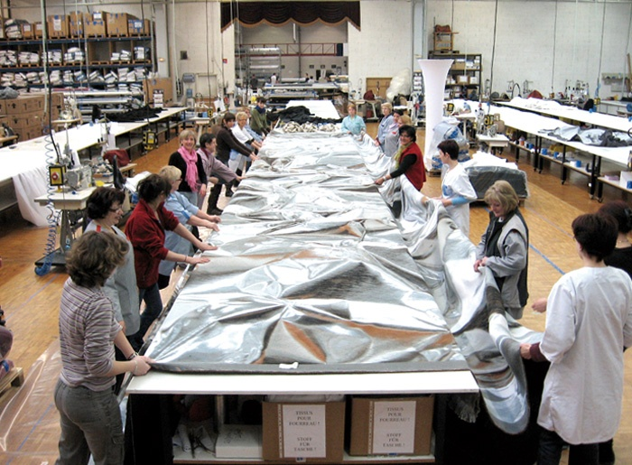
Outlook: 1870 versus 2012
1870 wrote the economist Gustav F. von Schmoller: „Factories are not winning because they produce permanently better products, but rather because the small master-craftsmen (enterprises) do not manage to go new ways.”
2012 - taking in account Schmollers statement - we do not have to worry, that the discussion on SME is coming soon to an end.
The approaches of Porter, Gilbert and the MIT show: also management science estimates very different prospects for SME in future. - Scientists working on SME do not need to worry to become unemployed.
Notes:
Schmoller 1870: „Geschichte der deutschen Kleingewerbe im 19. Jahrhundert“

Slide 45
Thank you and see you again!
www.japan-germany.org

